Slide 1
Chapter 12
Monetary and Fiscal Policy

Slide 2
Introduction
In this chapter we use the IS-LM model developed in Chapter 11 to show how monetary and fiscal policy work
Fiscal policy has its initial impact in the goods market
Monetary policy has its initial impact mainly in the assets markets
Because the goods and assets markets are interconnected, both fiscal and monetary policies have effects on both the level of output and interest rates
Expansionary/contractionary monetary policy moves the LM curve to the right/left
Expansionary/contractionary fiscal policy moves the IS curve to the right/left

Slide 3
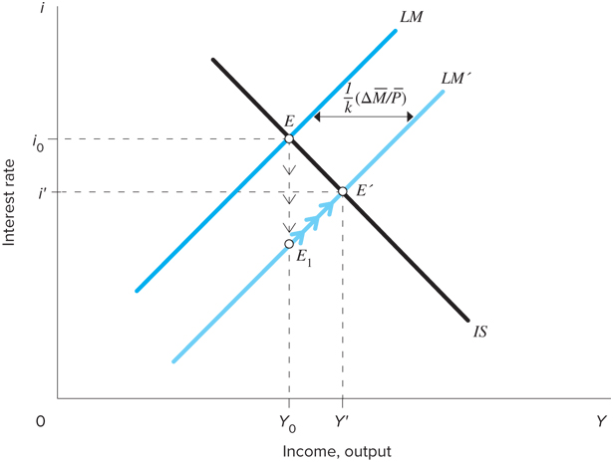
Monetary Policy
The Federal Reserve is responsible for monetary policy in the U.S. → conducted mainly through open market operations
Open market operations: buying and selling of government bonds
Fed buys bonds in exchange for money → increases the stock of money

Slide 4
Monetary Policy
Adjustment to the monetary expansion:
Increase in money supply creates excess supply of money
Public buys other assets
Asset prices increase, yields decrease → move to point E₁
Decline in interest rate results in excess demand for goods
Output expands and move up LM’ schedule

Slide 5
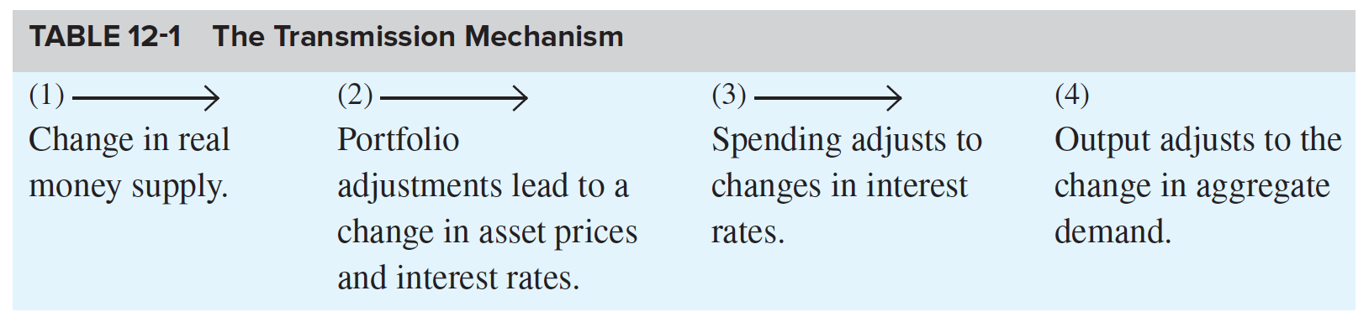
Transition Mechanism
Two steps in the transmission mechanism (the process by which changes in monetary policy affect AD):
An increase in real balances generates a portfolio disequilibrium
A change in interest rates affects AD

Slide 6
The Liquidity Trap
Two extreme cases arise when discussing the effects of monetary policy on the economy → first is the liquidity trap
Liquidity trap = a situation in which the public is prepared, at a given interest rate, to hold whatever amount of money is supplied
Implies the LM curve is horizontal → changes in the quantity of money do not shift it
Monetary policy has no impact on either the interest rate or the level of income → monetary policy is powerless
Possibility of a liquidity trap at low interest rates is a notion that grew out of the theories of English economist John Maynard Keynes

Slide 7
Banks’ Reluctance to Lend
Two extreme cases arise when discussing the effects of monetary policy on the economy → second is the reluctance of banks to lend
Another situation in which monetary policy is powerless to alter the economy → break down in the transmission mechanism
Despite lower interest rates and increased demand for investment, banks may be unwilling to make the loans necessary for the investment purchases
If banks made prior bad loans that are not repaid, may become reluctant to make more, despite demand → prefer instead to lend to the government (safer)

Slide 8
What’s going on in the Economy today???
Federal Funds Rate close to zero
Liquidity trap
Banks reluctant to make loans: high reserves deposit with FED
https://www.youtube.com/watch?v=p47uvsjB5E0

Slide 9
The Classical Case
The opposite of the horizontal LM curve is the vertical LM curve which is called the classical case
Demand for money is unresponsive to the interest rate
Given the equation for the LM curve, , implies h = 0
Rewrite the above equation with h = 0:
Implies that NGDP depends only on the quantity of money → quantity theory of money

Slide 10
The Classical Case
When the LM curve is vertical
A given change in the quantity of money has a maximal effect on the level of income
Shifts in the IS curve do not affect the level of income
Vertical LM curve implies the comparative effectiveness of monetary policy over fiscal policy
“Only money matters” for the determination of output
Requires that the demand for money be irresponsive to i → important issue in determining the effectiveness of alternative policies https://www.youtube.com/watch?v=YWrWQ4TUVW0

Slide 11
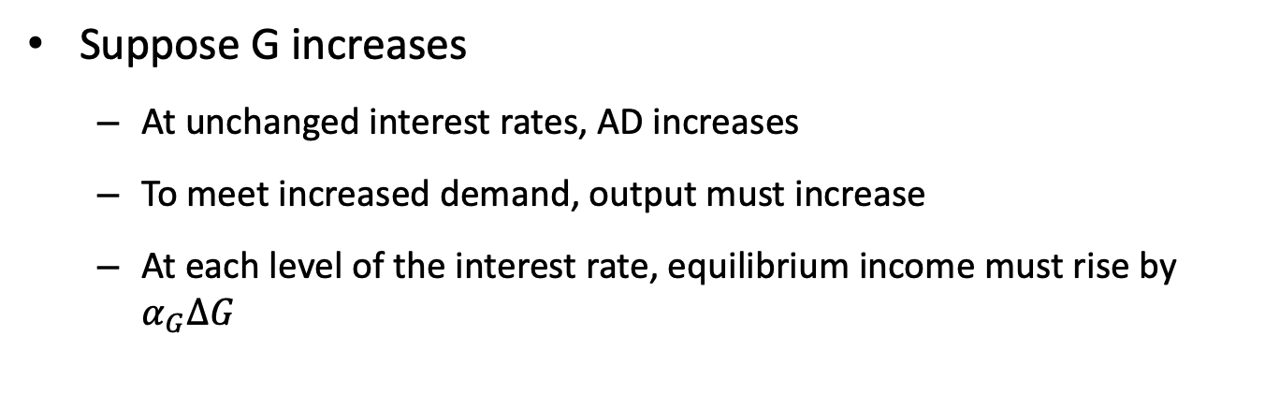
Fiscal Policy and Crowding Out
The equation for the IS curve is:
The fiscal policy variables, G and t, are within this definition
G is a part of A
t is a part of the multiplier
Fiscal policy actions, changes in G and t, affect the IS curve
Suppose G increases
At unchanged interest rates, AD increases
To meet increased demand, output must increase
At each level of the interest rate, equilibrium income must rise by $α_{G}∆G$

Slide 12
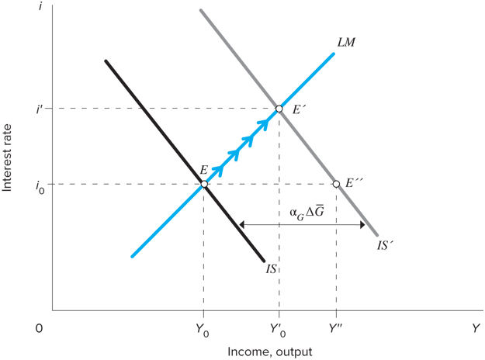
Fiscal Policy and Crowding Out
If government expenditures increase, equilibrium moves to from E to E”
The goods market is in equilibrium at E”, but the money market is not:
Because Y has increased, the demand for money also increases → interest rate increases
Firms’ planned investment spending declines and AD falls → move up the LM curve to E’

Slide 13
Fiscal Policy and Crowding Out
Comparing E to E’: increased government spending increases income and the interest rate
Comparing E’ to E”: adjustment of interest rates and their impact on AD dampen expansionary effect of increased G
Income increases to Y’₀ instead of Y”

Slide 14
The Composition of Output and the Policy Mix
Monetary policy operates by stimulating interest-responsive components of AD
Fiscal policy operates through G and t → impact depends upon what goods the government buys and what taxes and transfers it changes
Table 12-2: Policy Effects on Income and Interest Rates
POLICY | EQUILIBRIUM INCOME | EQUILIBRIUM INTEREST RATES
Monetary expansion | + | −
Fiscal expansion | + | +

Slide 15
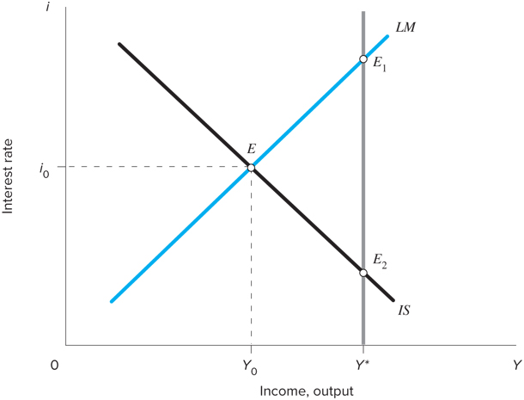
The Composition of Output and the Policy Mix
Choices for reaching full employment from point E:
Fiscal policy expansion, moving to point E₁, with higher income and higher interest rates
Monetary policy expansion, resulting in full employment with lower interest rates at point E₂
A mix of fiscal expansion and accommodating monetary policy resulting in an intermediate position

Slide 16
The Composition of Output and the Policy Mix
Policies all increase output, but impact sectors differently
Who should be the primary beneficiary of expansion?
An expansion through a decline in interest rates and increased investment spending?
An expansion through a tax cut and increased personal consumption?
An expansion in the form of an increase in the size of the government?

